Slide 1

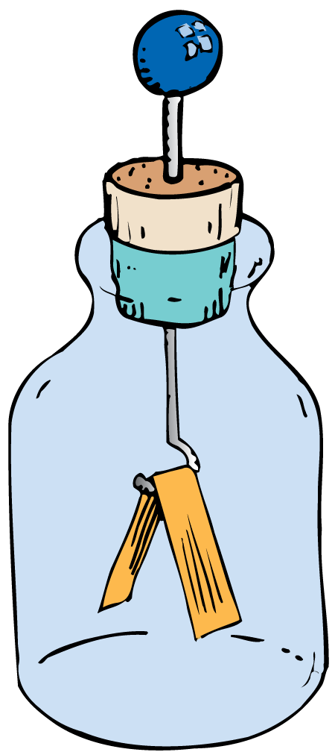

Electrostatics Notes
Electrostatics involves electric charges, the forces between them, and their behavior in materials.

Slide 2
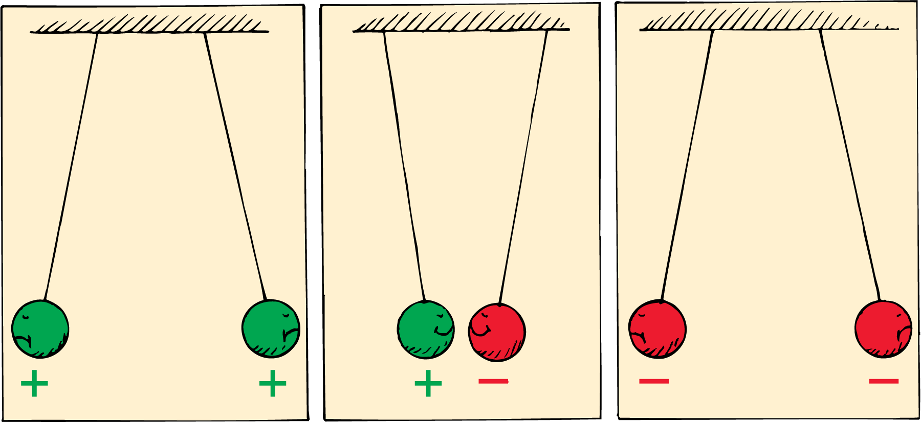
Electrical Forces and Charges
The fundamental rule at the base of all electrical phenomena is that like charges repel and opposite charges attract.

Slide 3
Electrical Forces and Charges
The Atom
Electrical forces arise from particles in atoms.
The protons in the nucleus attract the electrons and hold them in orbit. Electrons are attracted to protons, but electrons repel other electrons.

Slide 4
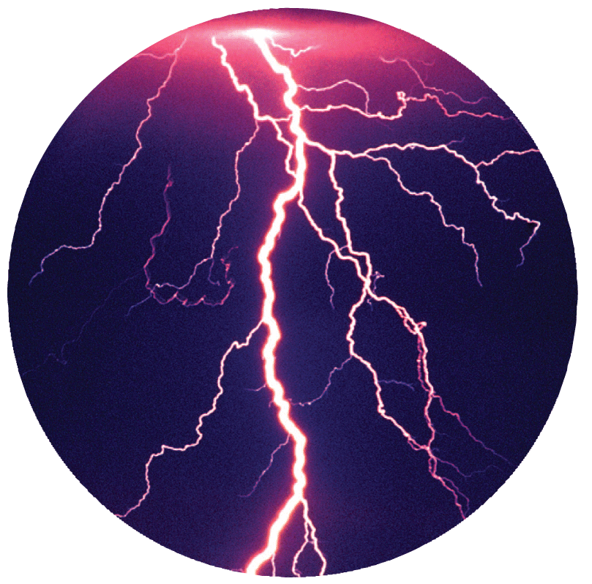
Electrical Forces and Charges
The fundamental electrical property to which the mutual attractions or repulsions between electrons or protons is attributed is called charge.

Slide 5
Conservation of Charge
An object that has unequal numbers of electrons and protons is electrically charged
Electrons and protons have electric charge.
In a neutral atom, there are as many electrons as protons, so there is no net charge.

Slide 6
Conservation of Charge
If an electron is removed from an atom, the atom is no longer neutral. It has one more positive charge than negative charge.
A charged atom is called an ion.
  A positive ion has a net positive charge; it has lost one or more electrons.
  A negative ion has a net negative charge; it has gained one or more extra electrons.

Slide 7
Conservation of Charge
Electrically Charged Objects
Matter is made of atoms, and atoms are made of electrons and protons.
An object that has equal numbers of electrons and protons has no net electric charge.
But if there is an imbalance in the numbers, the object is then electrically charged.
An imbalance comes about by adding or removing electrons.

Slide 8
Conservation of Charge
The innermost electrons in an atom are bound very tightly to the oppositely charged atomic nucleus.
The outermost electrons of many atoms are bound very loosely and can be easily dislodged.
How much energy is required to tear an electron away from an atom varies for different substances.

Slide 9
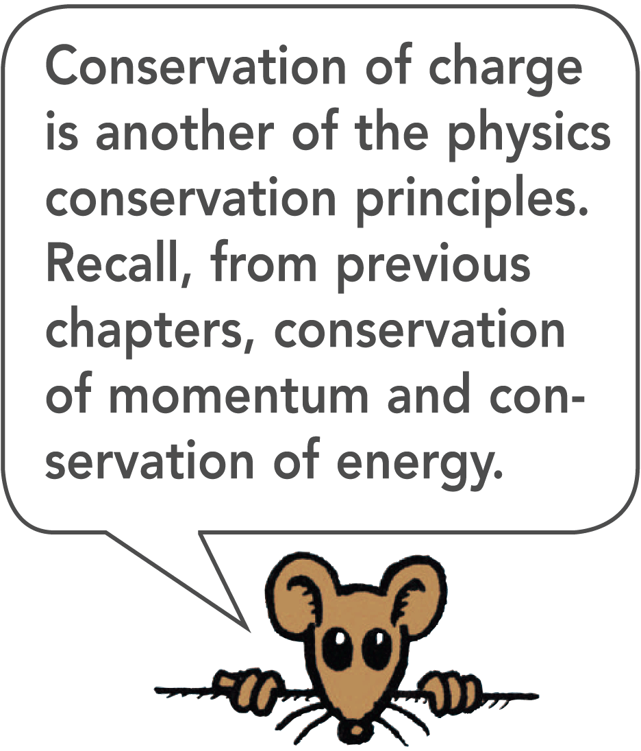
Conservation of Charge
Principle of Conservation of Charge
Electrons are neither created nor destroyed but are simply transferred from one material to another. This principle is known as conservation of charge.
In every event, whether large-scale or at the atomic and nuclear level, the principle of conservation of charge applies.

Slide 10
Coulomb’s Law
Coulomb’s law states that for charged particles or objects that are small compared with the distance between them, the force between the charges varies directly as the product of the charges and inversely as the square of the distance between them.

Slide 11
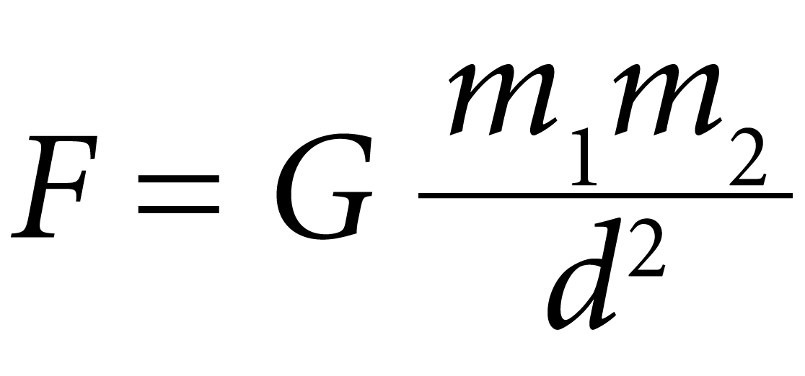
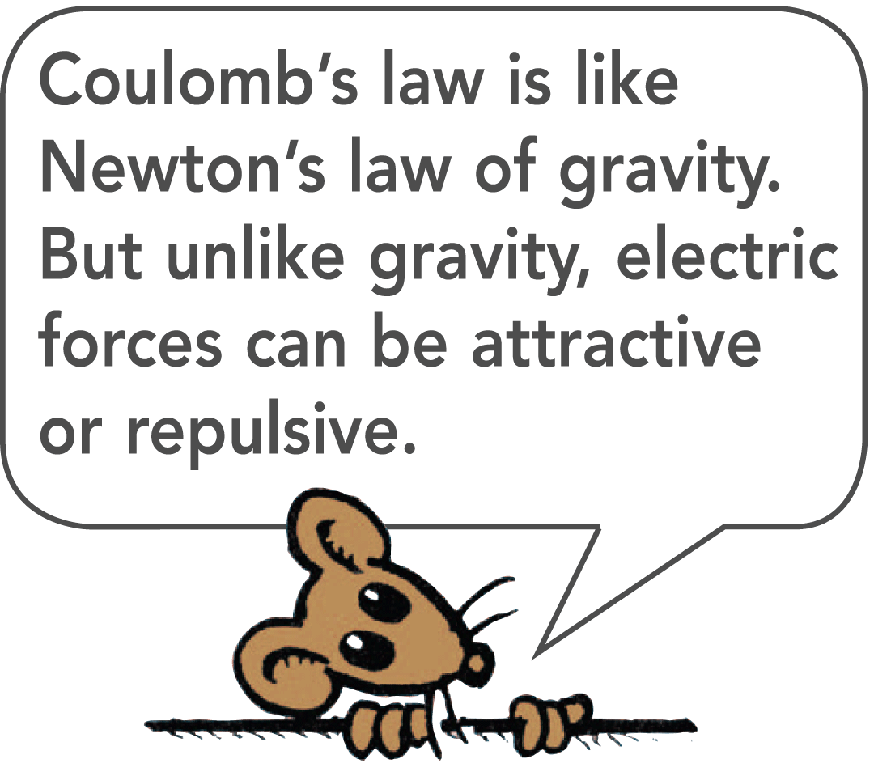
Coulomb’s Law
Newton’s law of gravitation that the gravitational force between two objects of mass m₁ and mass m₂ is proportional to the product of the masses and inversely proportional to the square of the distance d between them:

Slide 12
Coulomb’s Law
Force, Charges, and Distance
The electrical force between any two objects obeys a similar inverse-square relationship with distance.
The relationship among electrical force, charges, and distance—Coulomb’s law—was discovered by the French physicist Charles Coulomb in the eighteenth century.

Slide 13
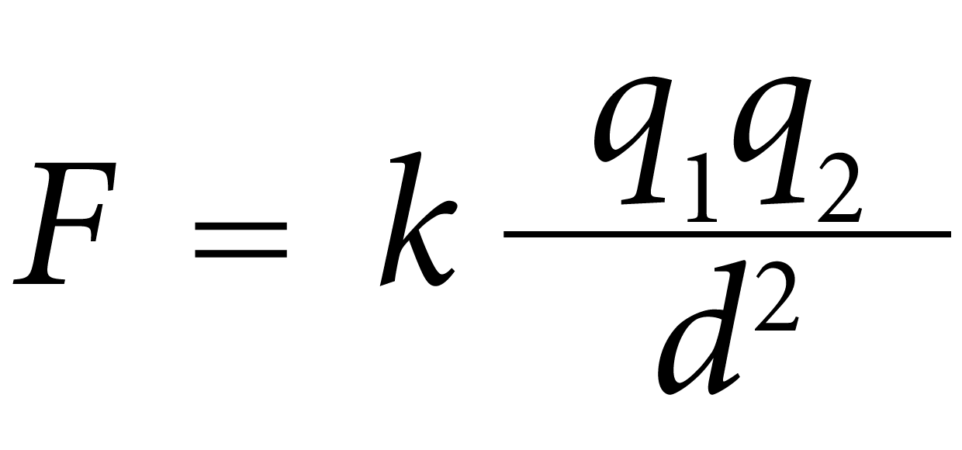
Coulomb’s Law
For charged objects, the force between the charges varies directly as the product of the charges and inversely as the square of the distance between them.
Where:
d is the distance between the charged particles.
q₁ represents the quantity of charge of one particle.
q₂ is the quantity of charge of the other particle.
k is the proportionality constant.

Slide 14
Coulomb’s Law
Coulomb
The SI unit of charge is the coulomb, abbreviated C.
A charge of 1 C is the charge of 6.24 × 10¹⁸ electrons.
A coulomb represents the amount of charge that passes through a common 100-W light bulb in about one second.

Slide 15
Coulomb’s Law
The Electrical Proportionality Constant
The proportionality constant k in Coulomb’s law is similar to G in Newton’s law of gravitation.
k = 9,000,000,000 N·m²/C² or 9.0 × 10⁹ N·m²/C²
If a pair of charges of 1 C each were 1 m apart, the force of repulsion between the two charges would be
9 billion newtons.
That would be more than 10 times the weight of a battleship!

Slide 16
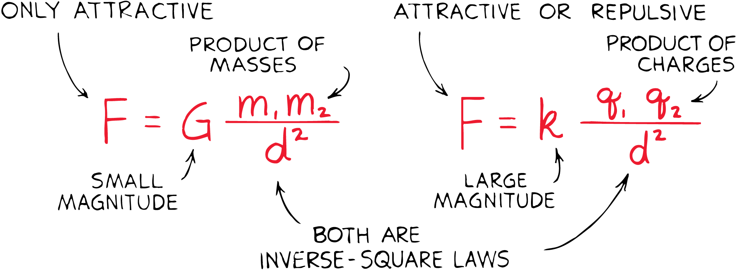
Coulomb’s Law – Comparing it to Gravitation
Newton’s law of gravitation for masses is similar to Coulomb’s law for electric charges.
Whereas the gravitational force of attraction between a pair of one-kilogram masses is extremely small, the electrical force between a pair of one-coulomb charges is extremely large.
The greatest difference between gravitation and electrical forces is that gravity only attracts but electrical forces may attract or repel.

Slide 17
Electric Field
The Electric field is defined as the Force that another charged object (test charge) would feel in the presence of the source charged object divided by the amount of the charge on the test charge.
E = F/q
Suppose a test charge q is placed in the electric field produced by a point-like field charge Q.
E = F/q = kQq/r²q = kQ/r²

Slide 18
Electric Field Lines
Electric field lines surround a charged object and point in the direction that a positive (+) test charge would be forced to move

Slide 19
Conductors and Insulators
Electrons move easily in good conductors and poorly in good insulators.

Slide 20
Conductors and Insulators
Materials through which electric charge can flow are called conductors.
  Metals are good conductors for the motion of electric charges because their electrons are “loose.”

Slide 21
Conductors and Insulators
Insulators, are poor conductors of electricity.
  Rubber and glass, for example—are tightly bound and remain with particular atoms.
  They are not free to wander about to other atoms in the material.

Slide 22
Conductors and Insulators
Semiconductors are materials that can be made to behave sometimes as insulators and sometimes as conductors.
  Atoms in a semiconductor hold their electrons until given small energy boosts.
  This occurs in photovoltaic cells that convert solar energy into electrical energy.
  Thin layers of semiconducting materials sandwiched together make up transistors.

Slide 23
Charging by Friction
Electrons are being transferred by friction when one material rubs against another.
  We can stroke a cat’s fur and hear the crackle of sparks that are produced.
  We can comb our hair in front of a mirror in a dark room and see as well as hear the sparks of electricity.
  We can scuff our shoes across a rug and feel the tingle as we reach for the doorknob.

Slide 24
Charging Conduction
Electrons can also be transferred from one material to another by simply touching.
  When a charged rod is placed in contact with a neutral object, some charge will transfer to the neutral object.
  This method of charging is called charging by contact.
  If the object is a good conductor, the charge will spread to all parts of its surface because the like charges repel each other.

Slide 25
Charging by Induction
If a charged object is brought near a conducting surface, even without physical contact, electrons will move in the conducting surface.

Slide 26
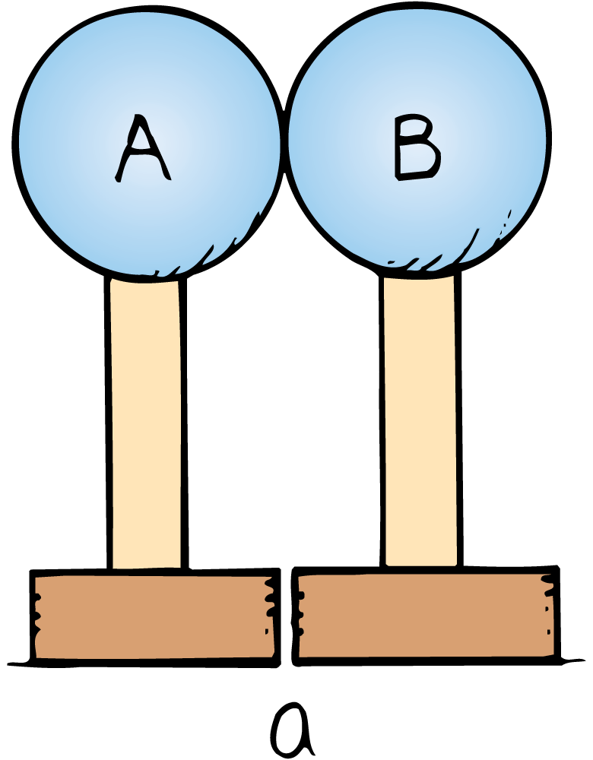
Charging by Induction
Charging by induction can be illustrated using two insulated metal spheres.
Uncharged insulated metal spheres touching each other, in effect, form a single noncharged conductor.

Slide 27
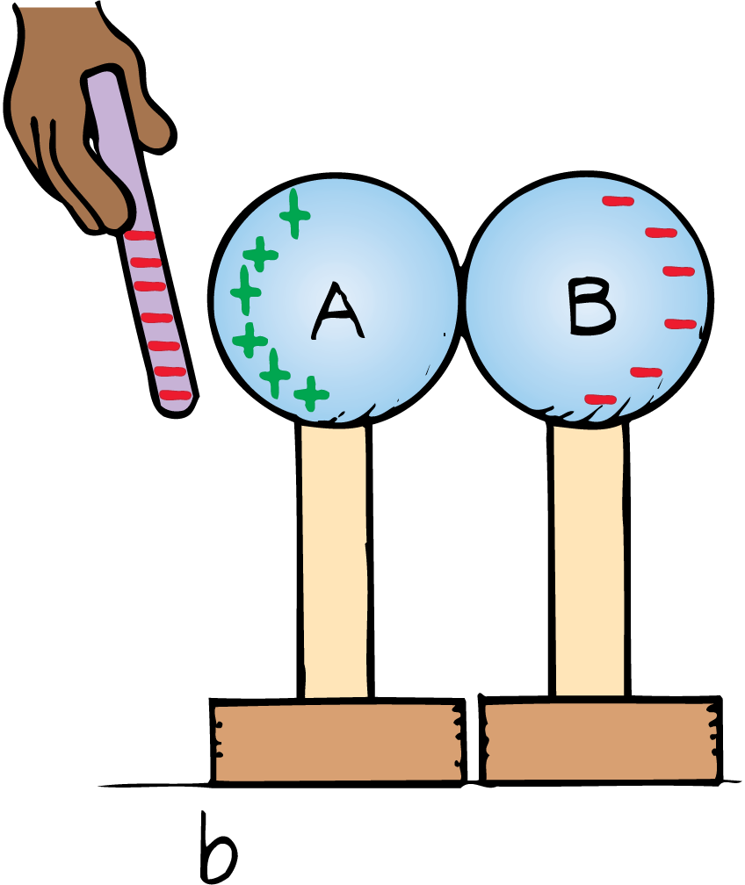
Charging by Induction
When a negatively charged rod is held near one sphere, electrons in the metal are repelled by the rod.
Excess negative charge has moved to the other sphere, leaving the first sphere with an excess positive charge.
The charge on the spheres has been redistributed, or induced.

Slide 28
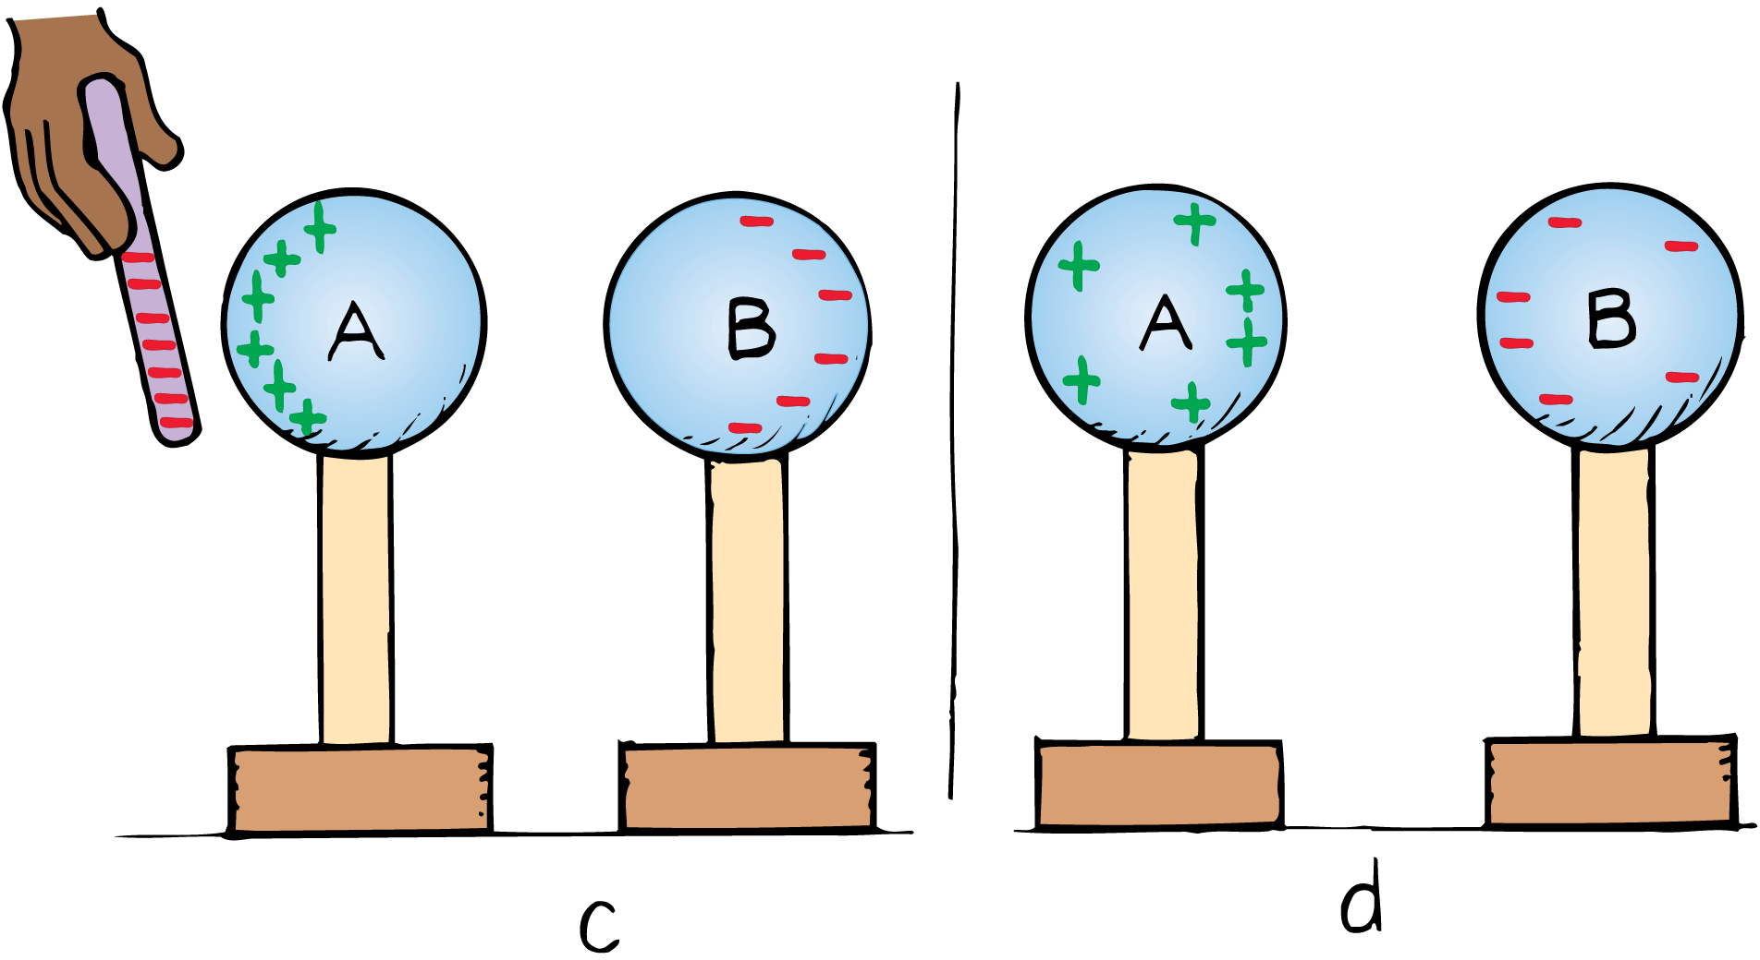
Charging by Induction
When the spheres are separated and the rod removed, the spheres are charged equally and oppositely.
They have been charged by induction, which is the charging of an object without direct contact.

Slide 29
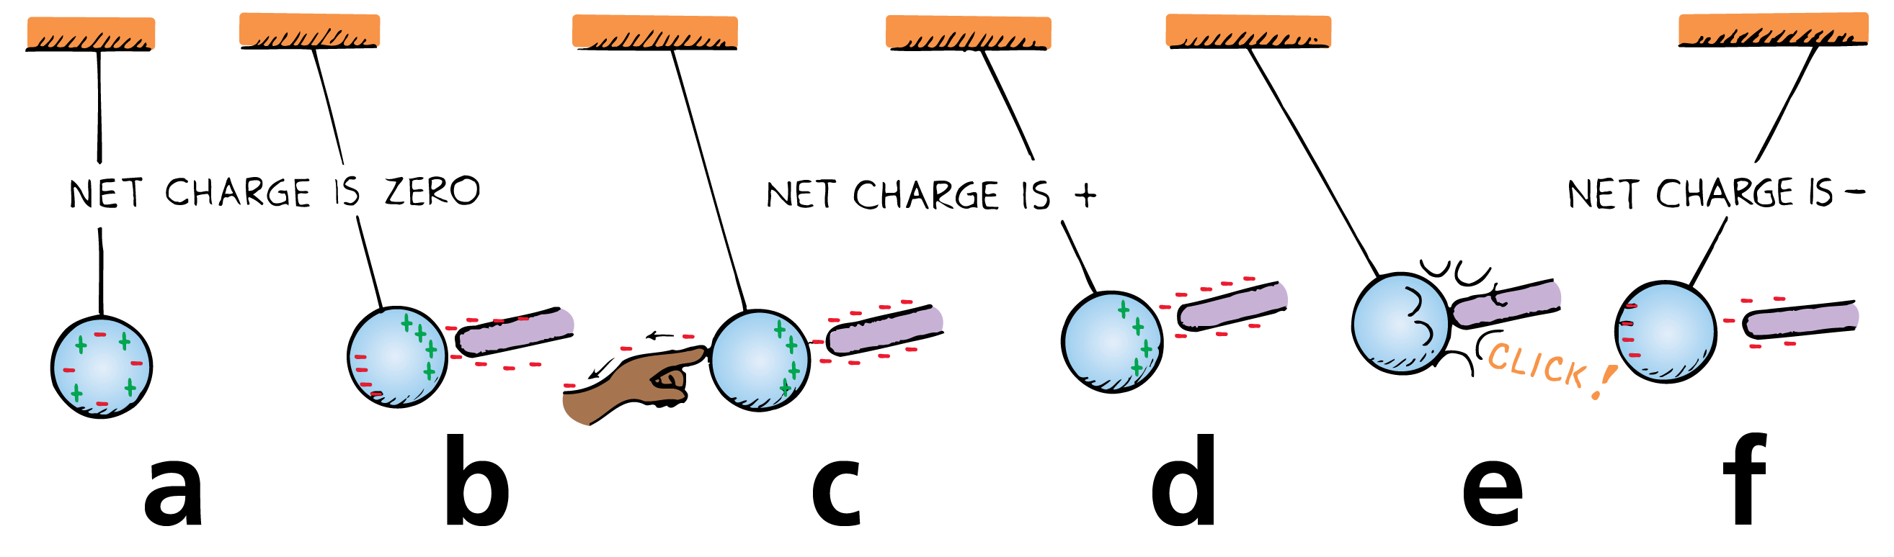
Charging by Induction
Charge induction by grounding can be illustrated using a metal sphere hanging from a nonconducting string.
  A charge redistribution is induced by the presence of the charged rod. The net charge on the sphere is still zero.
  Touching the sphere removes electrons by contact and the sphere is left positively charged.
  The positively charged sphere is attracted to a negative rod.
  When electrons move onto the sphere from the rod, it becomes negatively charged by contact.

Slide 30
Charging by Induction
When we touch the metal surface with a finger, charges that repel each other have a conducting path to a practically infinite reservoir for electric charge—the ground.
When we allow charges to move off (or onto) a conductor by touching it, we are grounding it.

Slide 31
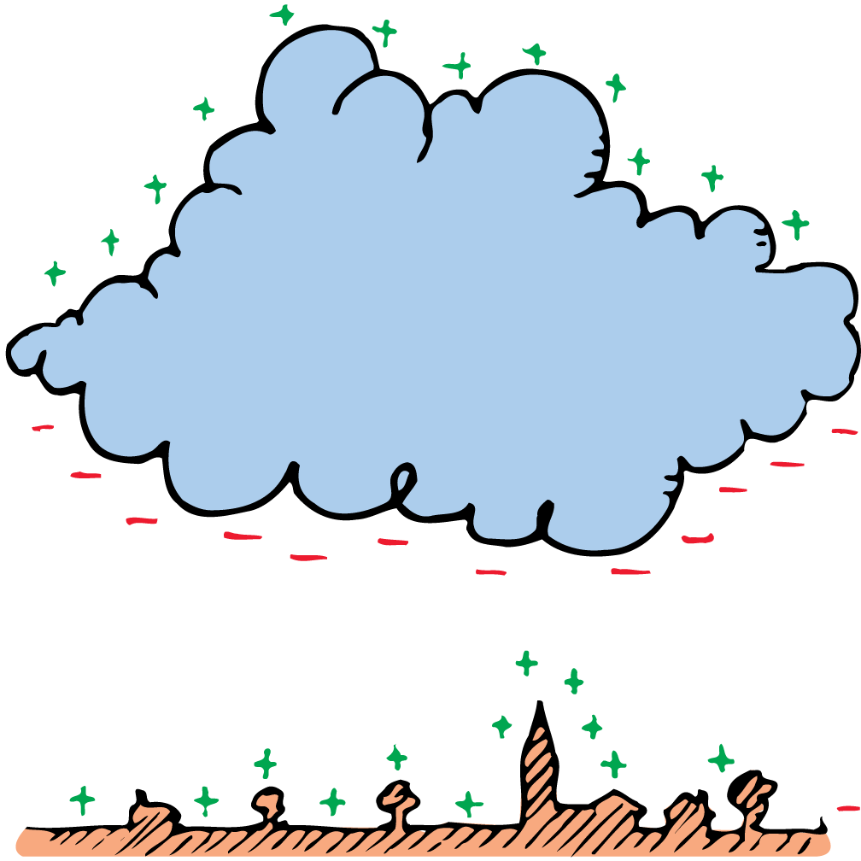
Charging by Induction
Charging by induction occurs during thunderstorms.
The negatively charged bottoms of clouds induce a positive charge on the surface of Earth below.
Most lightning is an electrical discharge between oppositely charged parts of clouds.
The kind of lightning we are most familiar with is the electrical discharge between clouds and oppositely charged ground below.

Slide 32
Charging by Induction
If a rod is placed above a building and connected to the ground, the point of the rod collects electrons from the air.
This prevents a buildup of positive charge by induction.
The primary purpose of the lightning rod is to prevent a lightning discharge from occurring.
If lightning does strike, it may be attracted to the rod and short-circuited to the ground, sparing the building.

Slide 33
Creating a Charge
In summary, objects are electrically charged in three ways.
  By friction, when electrons are transferred by friction from one object to another.
  By conduction (aka contact), when electrons are transferred from one object to another by direct contact without rubbing.
  By induction, when electrons are caused to gather or disperse by the presence of nearby charge without physical contact.

